Slide 1
Instructions for Presenters
This presentation is designed to provide law enforcement trainers with the information and guidance necessary to conduct a basic training on vicarious trauma.
This presentation includes clearly outlined speaking points for each slide, as well as exercises, to lead a workshop for 1–1.5 hours.
Please review the notes attached to each slide. You may choose to skip certain exercises, add your own, or pull out particular slides to conduct a shorter, more focused training for staff.

Slide 2
Introduction to Vicarious Trauma for Law Enforcement
This product was produced by Northeastern University's Institute on Urban Health Research and Practice, in collaboration with the Center for Violence Prevention and Recovery at the Beth Israel Deaconess Medical Center and the International Association of Chiefs of Police, and supported by grant number 2013-VF-GX-K011, awarded by the Office for Victims of Crime, Office of Justice Programs, U.S. Department of Justice. The opinions, findings, and conclusions or recommendations expressed in this product are those of the contributors and do not necessarily represent the official position or policies of the U.S. Department of Justice.
Notes:
Welcome, Introductions
This presentation was created for and made available through the Vicarious Trauma Toolkit, an online repository of tools and research that provides the knowledge and skills necessary for organizations to address the vicarious trauma needs of their staff. For more information, visit https://vtt.ovc.ojp.gov/.

Slide 3
Today, we will—
define vicarious trauma and traumatization, secondary traumatic stress, compassion fatigue, burnout, resilience, and vicarious resilience;
discuss how working with a traumatized population affects law enforcement staff;
discuss the impact of vicarious trauma on organizations; and
identify particular strategies that enhance both personal and professional resilience.
Notes:
We are focused on these objectives as we move into the presentation.

Slide 4
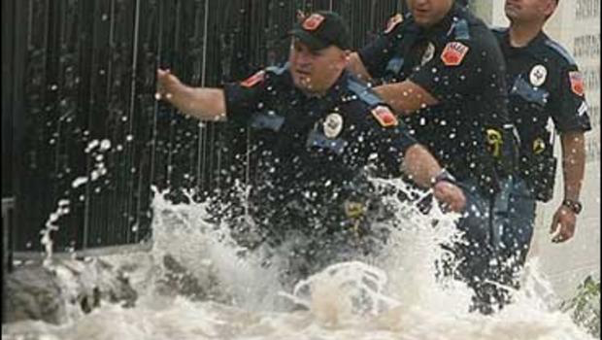
“The expectation that we can be immersed in suffering and loss daily and not be touched by it is as unrealistic as expecting to be able to walk through water without getting wet.”
(Remen, 2006)
Notes:
[Read slide.]
As law enforcement officers, the trauma we bear witness to everyday undoubtedly affects us. The purpose of this training is to understand how it affects us and what can be done about it.

Slide 5
Vicarious trauma
Critical incident stress
Vicarious traumatization
Secondary traumatic stress
Compassion fatigue
Burnout
Stress​
  Acute
  Chronic
Traumatic stress
Notes:
We are going to begin by defining terms. We’ll start with stress. Technically, stress is defined simply as a reaction to a stimulus that disturbs our physical or mental equilibrium. Stress can be experienced in many ways: acute stress is sudden, severe, and brief; chronic stress refers to constant or frequently recurring stressful events; and traumatic stress relates to a life-or-death type of event. We will return to that in a few minutes.
Looking at the terms on the right, there are many words that describe the impact of vicarious trauma throughout the field. Although each of these terms have different definitions and describe slightly different reactions, they are used interchangeably. What all these terms have in common is that they are trying to describe the negative reactions to work-related trauma exposure by law enforcement personnel. We begin with stress because understanding how the body responds to stress is imperative to understanding not only how we are reacting to the work, but also what the victims/survivors are experiencing. Their trauma is our trauma exposure.

Slide 6
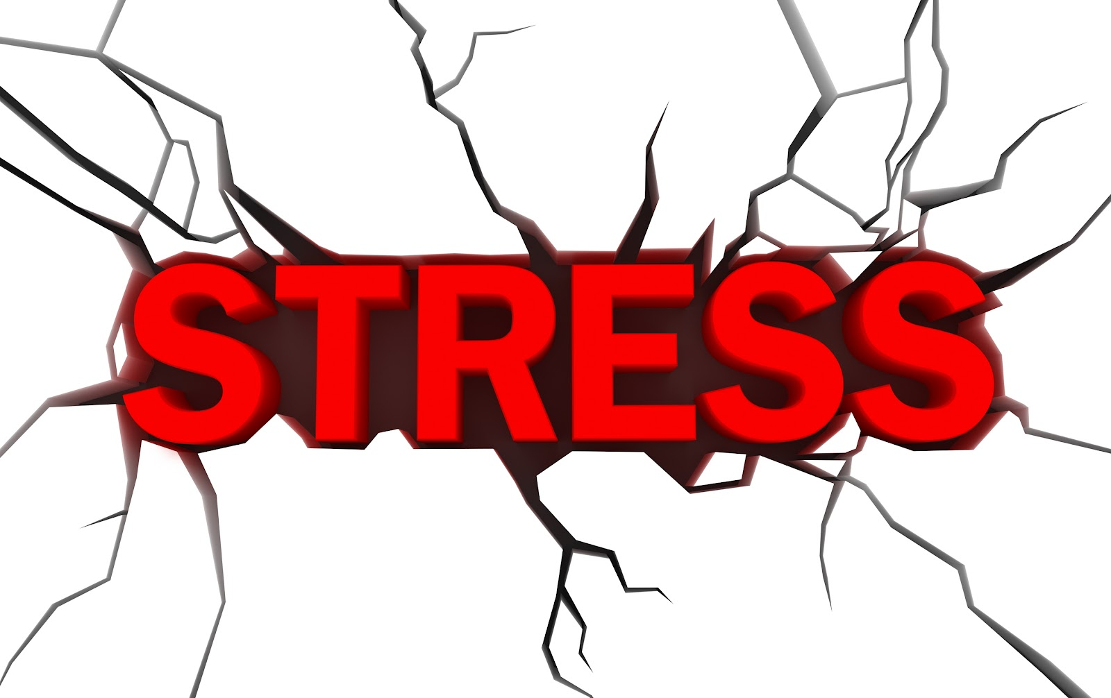
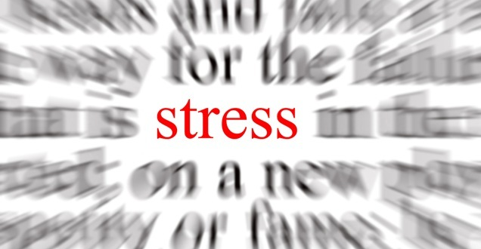
Notes:
Everyone knows what stress is. We have all experienced the feeling of being stressed for one reason or another, sometimes several times a day. We also know what stress feels like: our muscles get tense, we become irritable and short tempered, our breathing becomes rapid and shallow, and our heart starts racing.
Exercise
Ask: “When was the last time you felt stressed? What was happening in your body?”
Great examples! But that’s not stress, that is DIStress, or the stress response. Let’s take a step back…

Slide 7
Stress is pressure exerted upon an object that can either strengthen or weaken it.
(Webster’s Dictionary)
Stress Response
Stressor
Weaken
Strengthen
Notes:
How do you define stress? Webster's Dictionary defines stress as “pressure exerted upon an object that can either strengthen or weaken it."
Exercise
[Use an aluminum paperclip to show how applied stress weakens some items. Open the paperclip so that is makes an S shape.]
Question: What is likely to happen if I bend this paperclip back and forth at this midpoint?
[Wait for answers. Then bend the paperclip until it breaks.]
So, while aluminum can be strong, in this case, repeated, applied stress at this midpoint weakens the paper clip and it breaks in half. Sometimes even strong materials can be subject to stress and break.
Question: Can you give an example of how stress can strengthen you?
[Wait for responses.]
Question: Can you give an example of how stress can weaken you?
[Wait for responses.]
You may consider stress like a muscle: building muscle requires muscle fibers to first be torn down so they can knit together to become stronger. Similarly, the death of a loved one can break us down or it can teach us how to handle loss; it can also strengthen or bring together family members. Similarly, having a baby and getting married are both joyful events, but they are stressful nonetheless, sometimes breaking us down and sometimes strengthening us.

Slide 8
Stress
Notes:
Stress has a bad reputation, but once you get to know a little more about it, you find that stress is actually quite complex. This chart shows how stress can affect our performance. When we talk about performance, we are talking about our capability to respond to a stressor or challenge. When we are in the green zone, we are relaxed and laid back. This feels great but doesn’t prepare us to respond to a stressor. The yellow zone indicates optimum stress. This is called ”Eustress.” This is the stress that gets us ready to take a test, focus on a task, or get out of a sticky situation smoothly. As our stress increases, our performance tends to suffer, as you can see in the orange zone, as exhaustion sets in. Confronted with even more stress, we begin to experience anxiety and panic and our performance level is at it’s lowest. Now let’s look at what is going on.

Slide 9
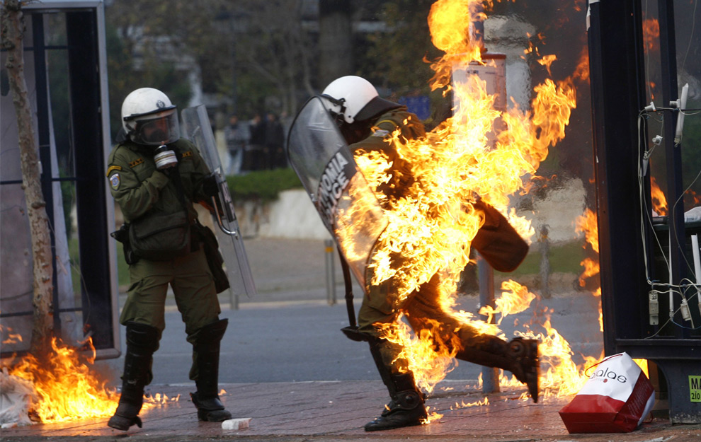
The Stress Response
The brain and body’s alarmed and alert response to a threatening situation.
Integral to the life of every living organism.
Our natural defense against danger.
Notes:
The stress response is an evolutionary, life-saving adaptation that exists among all living creatures. When we are confronted with a life-threatening event, this fight, flight, or freeze reaction is what gives us the ability to take instantaneous action, even before our thinking brain catches up. Our nervous system responds by releasing a flood of stress hormones, including adrenaline and cortisol. These hormones rouse the body for emergency action. Our heart pounds faster, muscles tighten, blood pressure rises, breath quickens, and senses become sharper.

Slide 10
Cumulative Stress
Notes:
Cumulative stress reactions are a less dramatic, more gradual form of stress reaction. They are usually related to low-intensity but more chronic stressors that pervade a person’s life and “pile up,” one on top of the other.
While we may think that a traumatic event or critical incident is most damaging, cumulative stress is likely to be as potentially problematic over the course of a public safety employee's career. This may be due to chronicity, an inability to escape exposure, or the fact that the most rewarding work in this field often requires repeated and persistent exposure to traumatic stimuli. Additionally, frequent mild stressful events can create high stress levels if not dealt with effectively on an ongoing basis.

Slide 11
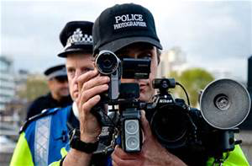
Taking a Closer Look…
        Trauma
        Traumatic stress
        Vicarious traumatization
Notes:
Now let’s take a closer look at trauma. A traumatic event is more than a stressor; it is a threat to one's safety, security, and sense of well-being.

Slide 12
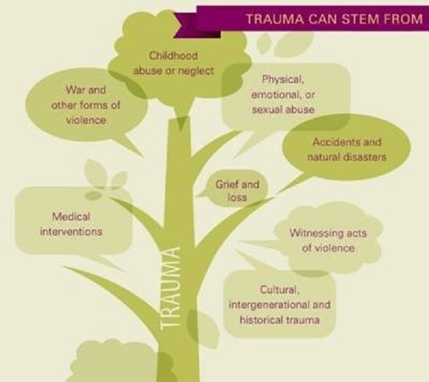
Human
Homicide
Sexual Assault
Assault/attack
War
Traumatic Events
Natural
Hurricane
Earthquake
Flood
Fire
On the Job
Fight or physical attack
Threat of physical harm
Accident
Notes:
Trauma is an event that is outside one’s normal experience that causes intense fear and can exceed one's ability to cope. Traumatic events can occur as a result of people's behaviors or actions, or as a result of natural occurrences. As public safety personnel, you are regularly exposed to trauma on the job. You can be exposed directly—by being involved in a critical incident, for example—or indirectly, by witnessing the traumatic experiences of another person.

Slide 13
What Makes an Event Traumatic?
    It involves a threat—real or perceived—to one’s physical or emotional well-being.
    It is overwhelming.
    It results in intense feelings of fear and lack of control.
    It leaves one feeling helpless.
    It changes the way a person understands the world, themselves, and others.
    (American Psychiatric Association, 2000)
Notes:
13
Though an event may not actually have threatened the life of a survivor, it is the perception—even for a split second—that life and bodily integrity is threatened that makes the event traumatic. Traumatic events overwhelm a person’s established coping mechanisms and result in the individual feeling intense fear, a lack of control, and helplessness in the face of the situation. Experiencing a traumatic event can ultimately change the way a person understands the world, themselves, and others.

Slide 14
Defining Traumatic Stress
Traumatic stress is the stress response to a traumatic event(s) in which one is a victim or witness.
  Repeated stressful and/or traumatic events can chronically elevate the body’s stress response.
  4 percent of victims suffer about 44 percent of the offenses.
                (Farrell and Pease, 1993)
Notes:
It is important to note that a single traumatic event and repeated traumatic events can chronically elevate the body’s stress response. Physical problems related to chronic stress include decreased immune response, chronic muscle tension, and increased blood pressure. These problems can eventually lead to serious life-threatening conditions such as a heart attack, kidney disease, and cancer. Cognitive function can also be impaired, affecting both attention and memory. This is important to note because, for the people we are responding to, there is a good probability that this is not their first victimization. For example, research tells us that child sexual abuse victims are three to five times more likely to experience subsequent adult victimization. Remember that person you encounter, who you may secretly feel is having an outsized physical and emotional reaction to their victimization, may very well be experiencing their 1st, 3rd, or 10th victimization.

Slide 15
Work-Related Trauma Exposure:
How Does it Affect Us?
Vicarious Trauma
Compassion Fatigue
Secondary Traumatic Stress
Indirect Trauma
Empathic Strain
PTSD
Critical Incident Stress
Burnout
Notes:
Is trauma contagious? It is well-known that helping traumatized people can affect us in many ways. What we call it differs widely. These are just some of the terms that come up when law enforcement describe their negative reactions to the work.
Exercise
Question: What term(s) do you use to refer to work-related trauma exposure?

Slide 16
Understanding the Difference Between Traumatic Stress and Vicarious Traumatization
Traumatic Stress
Extreme emotionality or absence of emotion
Fearful, jumpy, exaggerated startle response
Flashbacks
Vicarious Traumatization
Overly involved with or avoidance of victim/survivor
Hypervigilance and fear for one's own safety (the world no longer feels safe and people can’t be trusted)
Intrusive thoughts and images, or nightmares from victims’ stories
Notes:
Here are some examples of the differences between a victim’s traumatic stress reactions and our vicarious traumatization reactions. We can experience these types of mirror reactions acutely, occasionally, or chronically.

Slide 17
Work-Related Trauma Exposure
DIRECT exposure to trauma
Post Traumatic Stress Disorder (PTSD)
Critical Incident Stress
INDIRECT exposure to trauma
Post Traumatic Stress Disorder (DSM-V, 2013)
Post Traumatic Stress Symptoms
Empathic Strain
Secondary Traumatic Stress Symptoms
Vicarious Traumatization
Compassion Fatigue
Post Traumatic Stress Symptoms
Notes:
Depending upon our work environment and job duties, we may be at risk for DIRECT and/or INDIRECT exposure to trauma. Trauma experienced by law enforcement includes both direct trauma, such as officer-involved shootings, assaults by suspects, threats, and traffic collisions [or your own examples]); and indirect trauma, such as serving death notifications, performing life-saving measures on victims, and investigating sexual assault and child abuse cases. It was only in 2013 that the American Psychiatric Association decided that those who are exposed to traumatic material through their work are actually at risk for developing PTSD.

Slide 18
Vicarious Trauma Toolkit Model
Work Related Trauma Exposure = Vicarious Trauma
Change in World View
Spectrum of Responses
Negative
Vicarious Traumatization
Secondary Traumatic Stress
Compassion Fatigue
Neutral
Impact Managed Effectively
Positive
Vicarious Resilience
Vicarious Transformation
Compassion Satisfaction
Notes:
This is the Vicarious Trauma Toolkit’s model of the effects of work-related trauma exposure. Vicarious trauma is the work-related trauma exposure that first responders experience in their everyday work. There are a number of ways we respond to this exposure. A change in world view is considered inevitable for those who work in this field. We will have more on that in the next slide.
The other spectrum of responses include those that are negative, neutral, or positive. We can experience reactions along this spectrum in any direction, with reactions varying from case-to-case and with prolonged exposure. This is a brand new way to conceptualize how we are impacted by our exposure to the variety of direct and indirect trauma that is a normal part of employment in this field.
Vicarious traumatization is the negative reaction to trauma work. It includes a collection of psychosocial symptoms victim advocates may experience through their work.
A neutral reaction may reflect ways that an individual's resilience, experience, support, and coping strategies manage the traumatic material to which they are exposed.
Vicarious resilience and transformation are newer concepts reflecting the positive response to the work. We may draw inspiration from a victim’s resilience that serves to build our own. Just as a victim can be transformed in positive ways by their trauma, so can officers by their work exposure to trauma. Compassion satisfaction reflects the sense of meaningfulness that is gained from the work. Each one of these positive outcomes can motivate us and, in turn, protect us against the negative effects of trauma exposure.

Slide 19
Change in World View
“I was taught that law enforcement work is dangerous. But I never realized it until I lost a close friend… I no longer trust anyone or any situation”
    – Officer on the loss of an officer/friend killed in the line of duty
Notes:
Exposure to vicarious trauma leads to a change in world view. This is considered to be the result of cumulative exposure to traumatic stimuli.
Empathy and empathic engagement with victims of trauma is a necessary skill we utilize to form connections, create a sense of safety, and express understanding to the people we help. Our ability to empathize is what makes us good officers; however, it can shift how we view the world. We may have started out life believing that the world is basically a good, safe, and predictable place; that people are basically good; and that nothing bad will happen to us if we avoid risks and dangerous situations. That assumptive view of the world is challenged by our ongoing exposure to incidents, accidents, and human cruelty. This shift in world view is thought to be an inevitable and permanent change among first responders.

Slide 20

    It’s the shift in how we view the world, view others, and sense danger around us…
Notes:
Though this shift is considered inevitable and permanent, there is an exception. Some of us may already feel that the world is an unsafe place because of our early experiences—perhaps growing up in unsafe or unstable homes and environments with violence or poverty, or in conditions where we were oppressed, or mistreated for our race or ethnic background. In these cases, we don’t necessarily have a shift in world view because we already know that the world is unsafe (Janoff-Bulman, 1992; Gilfus, 1999).

Slide 21
Prevalence of Vicarious Traumatization Among Law Enforcement
Across sectors, 40–80 percent of helping professionals experience high rates of secondary trauma.
Among 28 global studies of PTSD, rescuers (fire fighters, ambulance personnel, police, search and rescue teams) had a prevalence rate of 10 percent compared with 4.4percent within the general population in developed countries.
Prevalence studies show rates of symptoms among first responders are much higher than 10 percent.
Notes:
Research shows that there can be negative effects from our work—what we call vicarious traumatization. We find that law enforcement is at significant risk for experiencing vicarious traumatization and, as you can see, studies demonstrate that this can result in high levels of stress and PTSD.

Slide 22

Secondary Traumatic Stress (STS)
“…the natural consequent behaviors and emotions resulting from knowing about a traumatizing event experienced by another…the stress resulting from helping or wanting to help a traumatized or suffering person.”
(Figley, 1995)
Notes:
22
Earlier research focused only on the negative impact of our work. Secondary Traumatic Stress and Compassion Fatigue are terms used to describe two of these negative responses.
Secondary Traumatic Stress, or STS, refers to an acute and symptom-based reaction to exposure to traumatic events and information, mirroring PTSD. From time to time we may find that we are badly affected by a particular case. It’s the one we bring home, that we have nightmares about, that we just can’t shake. Experiencing STS reflects a combination of our life experience, what our day/week/month is like, what is happening at our agency, and what is happening in our personal life. Having functional and healthy personal and professional supports in place can lessen the negative affect that these difficult cases have on us.

Slide 23

Compassion Fatigue
“A combination of physical, emotional, and spiritual depletion associated with caring for patients in significant emotional pain and physical distress.”
(Anewalt, 2009; Figley, 1995)
Notes:
Compassion fatigue is the exhaustion we feel from bearing witness to the suffering of another for whom we are caring. Trauma does not need to be present. This term is more commonly used in healthcare, as caregivers bear witness to human suffering due to illness or pain, but not necessarily trauma.
Compassion fatigue is a cumulative experience that can also result in burnout over time.
Compassion fatigue is different from burnout in that the cause of the injury is always related to caring about, caring for, or exposure to victims, while burnout can result from any type of stress.

Slide 24

What About Burnout?
Notes:
Burnout is “a state of physical, emotional, and mental exhaustion caused by long-term involvement in emotionally demanding situations.” Symptoms include depression, cynicism, boredom, loss of compassion, and discouragement (Pines and Aronson, 1988).
Any profession can experience burnout; it is not particular to those working with a traumatized population. However, chronic, untreated vicarious traumatization can lead to burnout. Burnout is not relieved in the short term, over a weekend or a vacation. A truly burned out first responder has lost their compassion not only for themselves, but for the people they are supposed to be helping, as well. Someone who is burned out is best served by taking a long-term leave from the work or by doing a completely different aspect of the work until their health and compassion can be restored.

Slide 25
Examples of Vicarious Traumatization: Personal
Rapid pulse/breathing, headaches, impaired immune system, fatigue, aches
Feelings of powerlessness, numbness, anxiety, guilt, fear, anger, depletion, hypersensitivity, sadness, helplessness, severe emotional distress or physical reactions to reminders
Irritability, sleep and appetite changes, isolate from friends and family, self destructive behavior, impatience, nightmares, hypervigilance, moody, easily startled or frightened
Loss of purpose, loss of meaning, questioning goodness versus evil, disillusionment, questioning prior religious beliefs, pervasive hopelessness
Diminished concentration, cynicism, pessimism, preoccupation with clients, traumatic imagery, inattention, self doubt, racing thoughts, recurrent and unwanted distressing thoughts
Withdrawn, decreased interest in intimacy or sex, isolation from friends or family, minimization of others’ concerns, projection of anger or blame, intolerance, mistrust
(Adapted from J. Yassen in Figley, 1995)
Physical
Emotional
Behavioral
Spiritual
Cognitive
Relational
Notes:
Here are some examples of the many ways that vicarious traumatization can affect our personal life and sense of well-being. Do you see yourself here?

Slide 26
Examples of Vicarious Traumatization: Professional
Performance
Morale
Relational
Behavioral
Decrease in quality/quantity of work, low motivation, task avoidance or obsession with detail, working too hard, setting perfectionist standards, difficulty with inattention, forgetfulness
Decrease in confidence, decrease in interest, negative attitude, apathy, dissatisfaction, demoralization, feeling undervalued and unappreciated, disconnected, reduced compassion
Detached/withdrawn from co-workers, poor communication, conflict, impatience, intolerance of others, sense of being the “only one who can do the job”
Calling out, arriving late, overwork, exhaustion, irresponsibility, poor follow-through
(Adapted from J. Yassen in Figley, 1995)
Notes:
At work, too, you see the effects of vicarious traumatization in performance, morale, behavior, and relationships. Take a look here, too, and see if you are identify any of these responses in yourself.

Slide 27

Contemplating the Effects
Personal Effects
Physical
Behavioral
Emotional
Spiritual
Cognitive
Relational
Professional Effects
Performance
Morale
Relational
Behavioral
Notes:
Exercise
Get with a partner and identify one or several ways in which you identify with the information on the previous slides. Partners will then report back to the group for discussion.
Questions: What was that like? What did you learn?
Listen for the affirmation of not being alone.

Slide 28
Risk Factors
  Personal
    Trauma history
    Pre-existing psychological disorder
    Young age
    Isolation, inadequate support system
    Loss in last 12 months
  Professional
    Lack of quality supervision
    High percentage of trauma survivors in caseload
    Little experience
    Worker/organization mismatch
    Lack of professional support system
    Inadequate orientation and training for role
    (Bonach and Heckert, 2012; Slattery and Goodman, 2009; Bell, Kulkarni, et al, 2003; Cornille and Meyers, 1999)
Notes:
Risk factors for vicarious traumatization are not limited to our personal strengths or weaknesses; organizations play a large role in reducing our risk.
Exercise
Look at this list of risk factors and raise your hand if you or your organization have one risk factor. Keep your hand raised if there are two. Keep your hand raised if there are three, four, five…
We are all at risk and that is why this information is so critical.

Slide 29
What is Self-Care?
Self-care is what people do for themselves to establish and maintain health, and to prevent and deal with illness.
It is a broad concept encompassing hygiene (general and personal), nutrition (type and quality of food eaten), lifestyle (sporting activities, leisure, etc.), environmental factors (living conditions, social habits, etc.) socio-economic factors (income level, cultural beliefs, etc.), and self-medication.’
(World Health Organization, 1998)
Notes:
Exercise
[Have everyone stand and take a stretch while you read the slide.]
This is what all humans need to live—activities that vary by culture, geography, personality, socioeconomics, age…
Consider how much more those who are traumatized and those who work with them need for their own sustenance. This goes beyond self-care, although caring for yourself is a good place to start.

Slide 30
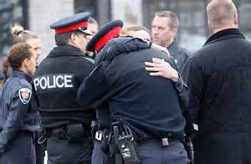
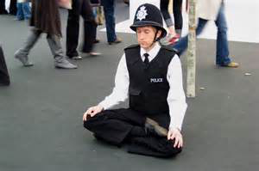

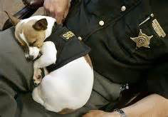
Personal Self Care Strategies
Notes:
These are a few key self-care strategies:
1. Having the support of others, both at work and at home, has been shown to be essential in the response to vicarious trauma. It can keep isolation at bay and it also helps to have people who understand your exposure to trauma at work.
2. Being creative in ways that absorb and focus your attention has been shown to reduce stress and strengthen resilience.
3. and 4. Eating healthfully (most of the time) and getting good sleep strengthens one’s immunity and body and brain function,.
Exercise
[If you have a large group, ask participants to work at their tables or in groups of 3 or 4 to discuss the exercise question below.]
Question: What do you do to take care of yourself?

Slide 31
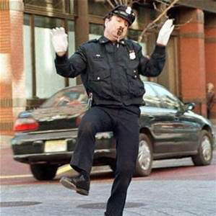
What is
Resilience is the process of adapting well in the face of adversity, trauma, tragedy, threats, or even significant sources of stress, such as family and relationship problems, serious health problems, or workplace and financial stressors.
It means “bouncing back” from difficult experiences.
        (American Psychological Association)
Notes:
31
One of the things that a good self-care plan does is increase our resilience. Increasing our resilience is essential for those of us in this work.

Slide 32
Vicarious Resilience
Involves the process of learning about overcoming adversity from the trauma survivor and the resulting positive transformation and empowerment through their empathy and interaction.
      (Hernandez, Gangsei, and Engstrom, 2007)
Notes:
There are ways that simply doing the work can increase our resilience—we can be inspired by and learn from those victims and survivors with whom we work or encounter. It stands to reason that if their trauma is “contagious,” then so can their resilience be vicarious resilience.
[Read slide]
Exercise (if time allows)
Working in small groups or pairs, think of a victim/survivor, another police officer, or even a family member who showed amazing resilience in the face of devastation. It can be in reference to any victim of a crime or accident. Without telling your partner the details about their trauma, describe how this person overcame it and “bounced back.” Describe how their resilience made you feel.

Slide 33
Impact of Vicarious Resilience
Greater perspective and appreciation of own problems
More optimistic, motivated, efficacious, and reenergized
Increased sense of hope, understanding, and belief in the possibility of recovery from trauma and other serious challenges
Profound sense of commitment to, and finding meaning from the work
    (Hernandez, et al, 2007; Engstrom, et al, 2008)
Notes:
These are some of the findings that researchers are making regarding vicarious resilience.

Slide 34
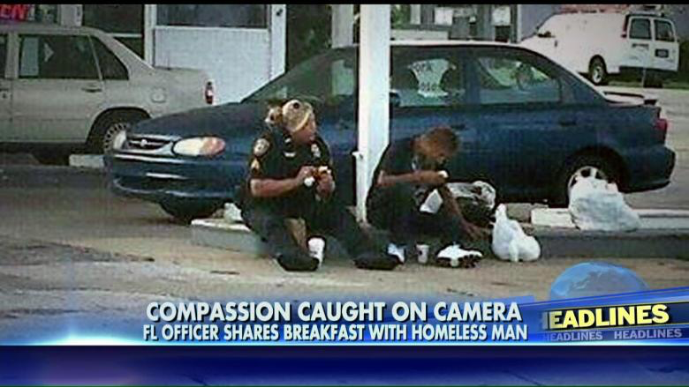
Acknowledging the Positive:
Compassion Satisfaction
Vicarious Transformation
Notes:
Compassion satisfaction is about the pleasure you derive from the work. You may feel positively about the meaningfulness of your contribution to the work or even to the greater good of society.
Vicarious transformation is an ongoing, intentional process by the worker that results in a deepened sense of connection with others, a greater appreciation of one’s life, and a greater sense of meaning and hope. This term comes from researcher Perlman, who earlier brought us the phrase vicarious traumatization—evidence of how this field is evolving.
Exercise (if time allows)
Working with a partner, discuss why/how this work is meaningful to you.

Slide 35

Self-Care Isn’t Everything…
Vicarious trauma is an occupational challenge for those working with trauma survivors
Organizations have an ethical mandate of a “duty to train,” wherein workers are taught about the potential negative effects of the work and how to cope.
(Munroe, J. F., in Figley, Compassion Fatigue, 1995)
Notes:
35
Sometimes we can be made to feel guilty that we are having difficult reactions to our trauma exposure from work—that perhaps we are not cut out to do this work; that if we just did a little more self-care, we would be fine. Self-care is important, but that is only half the story. Our organizations play a major role in our well-being, resilience, and ability to remain in the work. We are going to turn our focus now to the responsibilities of our organizations.

Slide 36
Vicarious Trauma-Informed Organization
Vicarious trauma (VT), the exposure to the trauma experiences of others, is an occupational challenge for the fields of victim services, emergency medical services, fire services, law enforcement, and others. Working with victims of violence and trauma has been shown to change the worldview of responders and can also put individuals and organizations at risk for a range of negative consequences.
A vicarious trauma-informed organization recognizes these challenges and assumes the responsibility for proactively addressing the impact of vicarious trauma through policies, procedures, practices, and programs.
Notes:
As we mentioned earlier, vicarious trauma is a challenge of the job, with potential for personal and professional impact. Given that this is work-related exposure, we will turn briefly to the critical importance of having vicarious trauma-informed organizations.

Slide 37
Key Aspects of a Healthy Organization
Leadership and Mission
  Effective leadership, clarity, and alignment with mission
Management and Supervision
  Clear, respectful, quality, inclusive of VT
Employee Empowerment and Work Environment
  Promotes peer support, team effectiveness
Training and Professional Development
  Adequate, ongoing, inclusive of VT
Staff Health and Wellness
  Devotes priority and resources to sustaining practices
POLICE
Notes:
[Review slide.]
These are the leading aspects of a healthy organization, as discussed in Organizational Psychology literature and other sources. The Vicarious Trauma Toolkit has developed an assessment tool to guide first responder organizations’ efforts to become healthy and vicarious-trauma informed. Called the Vicarious Trauma Organizational Readiness Guide, VT-ORG for short, it identifies strengths and gaps in each of these five areas. After completing the VT-ORG, the Vicarious Trauma Toolkit can then guide the user to actual policies and programming to assist efforts to become a healthier and more vicarious trauma-informed organization.

Slide 38
Organizational
Creating a healthy work environment/organizational culture
Providing supportive leadership
Providing quality supervision
Debriefing staff
Hosting staff/team meetings, retreats, formal and informal opportunities to socialize
Encouraging formal and informal peer support Acknowledging stress, STS, and VT as real issues
Providing training and education, including orientation to the organization and role
Encouraging staff health and wellness (e.g., practices, programs, policies)
Notes:
Listed here are some of the key evidence-based strategies for organizations to consider.
Exercise
Count the number of strategies that your organization is utilizing right now. Stand up if your organization has incorporated one of these strategies; stay standing if two are utilized; three? Stay standing if you have 4 or more.
Question: Can you name some of the most creative team-building activities you are doing in your organization?

Slide 39




Peer Support
    Teach effective communication skills
    Encourage trusting, mutual relationships
    Model conflict resolution
    Emphasize collaboration and teamwork
Notes:
Consistently, research underscores the critical importance of peer support in our workplace. The support can be formally or informally but the key is the healthy support and connection among peers. This is a major way that organizations can support our resilience.
These are some of the peer-driven support networks and assistance programs that specialize in working with first responders:
First Responder Support Network: West Coast Post-Trauma Retreat
California Peer Support Network
South Carolina and Virginia Law Enforcement Assistance Programs.
All of these have clinical oversight. Information for these organizations can be found in the Vicarious Trauma Toolkit.

Slide 40
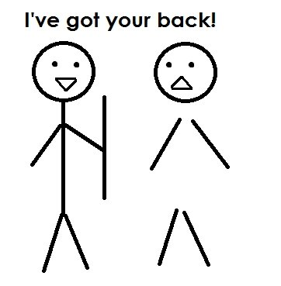
Notes:
Who’s got your back? Think about who that may be. By the end of today, tell that person(s) you were thinking of them.

Slide 41
What Happens When Organizations Don’t Address Vicarious Trauma?
Lost Productivity
Staff Turnover
Decreased morale, cohesion, communication, collaboration, quality of services
Erosion of concentration, focus, decisionmaking, motivation, performance
Poor Organizational Health
Time and resources needed to hire and train new staff drains remaining staff
Notes:
If organizations don’t pay attention to the health and well-being of their members and the impact of trauma exposure, the results can be devastating: lost productivity, poor organizational health, and staff turnover. If left unattended, the negative impact will prevent the organization from doing its critical work.

Slide 42
“First responders bear witness to damaging and cruel treatment experienced by others, shattering any assumptions of invulnerability.”
(Janoff-Bulman, 1992)
Notes:
Why is it important for us and our organizations to address vicarious trauma?
[Read slide.]

Slide 43

The VTT and VT-ORG
The Vicarious Trauma Toolkit (VTT) is an online, state-of-the-art, evidence-informed toolkit to support agencies’ responses to vicarious trauma in victim assistance professionals, law enforcement officers, firefighters, EMS, and other first responders who work with victims of crime.
Learn more about the VTT and the Vicarious Trauma Organizational Readiness Guide (VT-ORG) at https://vtt.ovc.ojp.gov/.
Notes:
Thank you, and take care of yourself and your coworkers!

Slide 44
References
Bell, Holly, Shanti Kulkarni, and Lisa Dalton. 2003. “Organizational Prevention of Vicarious Trauma.” Families in Society: The Journal of Contemporary Social Services 84(4): 463–470. doi:10.1606/1044-3894.131.
Berger, William, Evandro Coutinho, Ivan Figueira, Carla Marques-Portella, Mariana Pires Luz, Thomas C. Neylan, Charles R. Marmar, and Mauro Vitor Mendlowicz. 2011. “Rescuers at Risk: A Systematic Review and Meta-Regression Analysis of the Worldwide Current Prevalence and Correlates of PTSD in Rescue Workers.” Social Psychiatry and Psychiatric Epidemiology 47(6): 1001–1011. doi:10.1007/s00127-011-0408-2.
Bonach, Kathryn, and Alex Heckert. 2012. “Predictors of Secondary Traumatic Stress Among Children’s Advocacy Center Forensic Interviewers.” Journal of Child Sexual Abuse 21(3): 295–314. doi:10.1080/10538712.2012.647263.
Bride, Brian E., Melissa Radey, and Charles R. Figley. 2007. “Measuring Compassion Fatigue.” Clinical Social Work Journal 35(3): 155–163. doi:10.1007/s10615-007-0091-7.

Slide 45
References (cont.)
Conrad, David, and Yvonne Kellar-Guenther. 2006. “Compassion Fatigue, Burnout, and Compassion Satisfaction Among Colorado Child Protection Workers.” Child Abuse & Neglect 30(10): 1071–1080. doi:10.1016/j.chiabu.2006.03.009.
Cornille, Thomas A., and Tracy Woodard Meyers. 1999. “Secondary Traumatic Stress Among Child Protective Service Workers: Prevalence, Severity and Predictive Factors.” Traumatology 5(1): 15–31. doi:10.1177/153476569900500105.
Engstrom, David, Pilar Hernandez, and David Gangsei. 2008. “Vicarious Resilience: A Qualitative Investigation Into Its Description.” Traumatology 14(3): 13–21. doi:10.1177/1534765608319323.
Farrell, Graham, and Ken Pease. 1993. Once Bitten, Twice Bitten: Repeat Victimisation and Its Implications for Crime Prevention. London: Home Office Police Research Group.
Figley, Charles R. 1995. Compassion Fatigue: Coping With Secondary Traumatic Stress Disorder In Those Who Treat The Traumatized. 1st edition. New York: Routledge.

Slide 46
References (cont.)
Gilfus, Mary E. 1999. “The Price of the Ticket: A Survivor-Centered Appraisal of Trauma Theory.” Violence Against Women 5(11): 1238–1257. doi:10.1177/1077801299005011002
Hernández, Pilar, David Gangsei, and David Engstrom. 2007. “Vicarious Resilience: A New Concept in Work With Those Who Survive Trauma.” Family Process 46(2): 229–241. doi:10.1111/j.1545-5300.2007.00206.x.
Hudnall , Beth. 2002. “Measuring Compassion Satisfaction as Well as Fatigue: Developmental History of the Compassion Satisfaction and Fatigue Test.” In Treating Compassion Fatigue, 107–19. Psychosocial Stress Series, No. 24. New York, NY, US: Brunner-Routledge.
Janoff-Bulman, Ronnie. 1992. Shattered Assumptions: Towards a New Psychology of Trauma. New York: Free Press.
Kessler, Ronald C., Johan Ormel, Maria Petukhova, Katie A. McLaughlin, Jennifer Greif Green, Leo J. Russo, Dan J. Stein, et al. 2011. “Development of Lifetime Comorbidity in the World Health Organization World Mental Health Surveys.” Archives of General Psychiatry 68(1): 90–100. doi:10.1001/archgenpsychiatry.2010.180.

Slide 47
References (cont.)
Mathieu, Françoise. 2012. “Compassion Fatigue.” In Encyclopedia of Trauma: An Interdisciplinary Guide, edited by Charles R. Figley, 1st edition, 904. Thousand Oaks, CA: SAGE Publications, Inc.
Munroe, James F., Jonathan Shay, Lisa Fisher, Christine Makary, Kathryn Rapperport, and Rose Zimering. 1995. “Preventing Compassion Fatigue: A Team Treatment Model.” In Compassion Fatigue: Coping with Secondary Traumatic Stress Disorder in Those Who Treat the Traumatized, edited by Charles R Figley, 209–231. New York: Brunner-Routledge.
Pearlman, Laurie Anne. 2016. “Headington Institute.” Headington Institute. Accessed November 8, 2016. www.headington-institute.org/.
Remen, Rachel Naomi. 2006. Kitchen Table Wisdom: Stories That Heal, 10th Anniversary Edition. New York: Riverhead Books.
Saakvitne, Karen W. 1999. Risking Connection: A Training Curriculum for Working With Survivors of Childhood Abuse. Lutherville, MD: Sidran Press.

Slide 48
References (cont.)
Slattery, Suzanne M., and Lisa A. Goodman. 2009. “Secondary Traumatic Stress Among Domestic Violence Advocates: Workplace Risk and Protective Factors.” Violence Against Women 1 (11): 1358–1379. doi:10.1177/1077801209347469.
Yassen, Janet. 1995. “Preventing Secondary Traumatic Stress Disorder.” In Compassion Fatigue: Coping With Secondary Traumatic Stress Disorder In Those Who Treat The Traumatized, edited by Charles R. Figley, 1 edition, 178–208. New York: Routledge.

